Slide 1

Hidden Markov Model
Phuc Dinh Hoang
Matriculation number: 1068106

Slide 2
Contents
Introduction
LearningAPI
Hidden Markov Algorithm
Methods
Implementation
Unit Test
Discussion

Slide 3
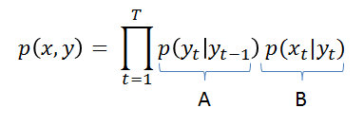

Hidden Markov Algorithm
A is a matrix of transition probabilities
B is either a matrix of observation probabilities (in the discrete case) or a vector of probability distributions (in the general case)
Fig. 1. Hidden Markov Algorithm
pi is a vector of initial state probabilities determining the probability of starting in each of the possible states in the model.

Slide 4
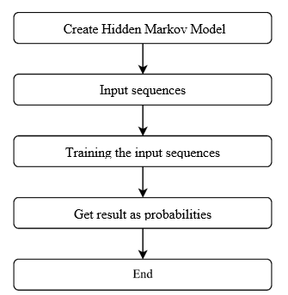
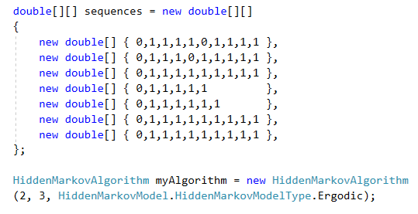
Implementation
Fig. 2. Architecture of the project

Slide 5
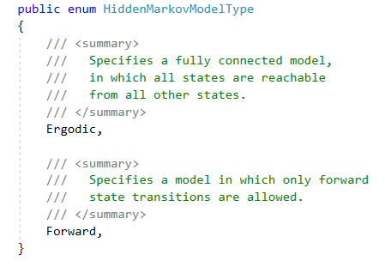
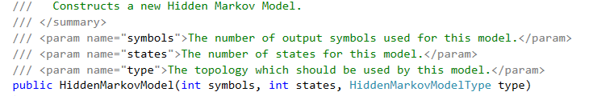
Implementation
Fig. 3. Input Sequences
Fig. 4. HiddenMarkovModelType
Fig. 5. Constructor of HMM

Slide 6
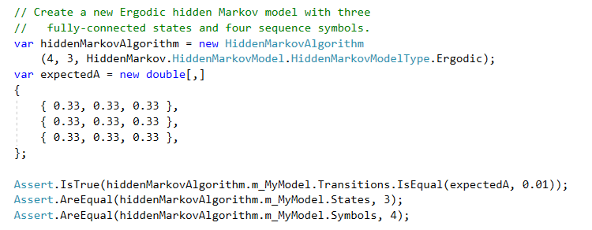
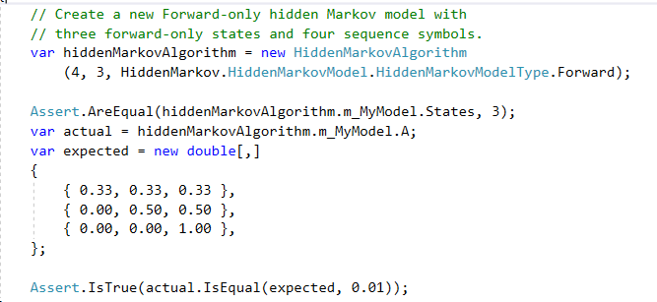
UnitTest
Fig. 6. Ergodic HMM
Fig. 6. Forward HMM

Slide 7
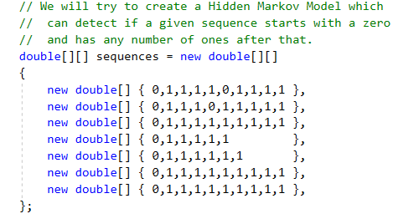
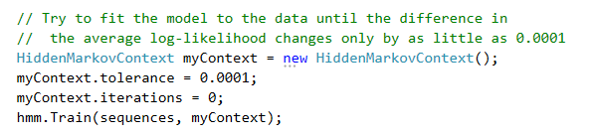
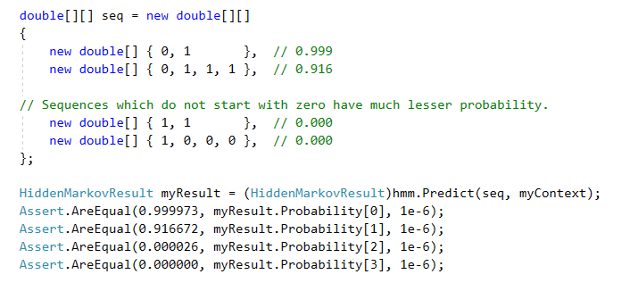
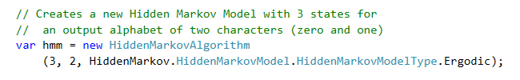
UnitTest
Fig. 6. Detect if a given sequence starts with a zero

Slide 8
Thank you for your listening

Slide 9
References
Open Source, Accord farmwork, 2019. [Online]. Available: http://accord-framework.net/docs/html/T_Accord_Statistics_Models_Markov_HiddenMarkovModel.htm. [Accessed 01 03 2019].
Bilmes, Jeff A. (1998). A Gentle Tutorial of the EM Algorithm and its Application to Parameter Estimation for Gaussian Mixture and Hidden Markov Models. Berkeley, CA: International Computer Science Institute. pp. 7–13.

